Slide 1

Case study 51:- AquaPure: Smart Water Delivery
By Yuvraj Jitendra Singh

Slide 2

Index
Problem Statement
Your solution
Working (Method/Mind map)
Conclusion.

Slide 3
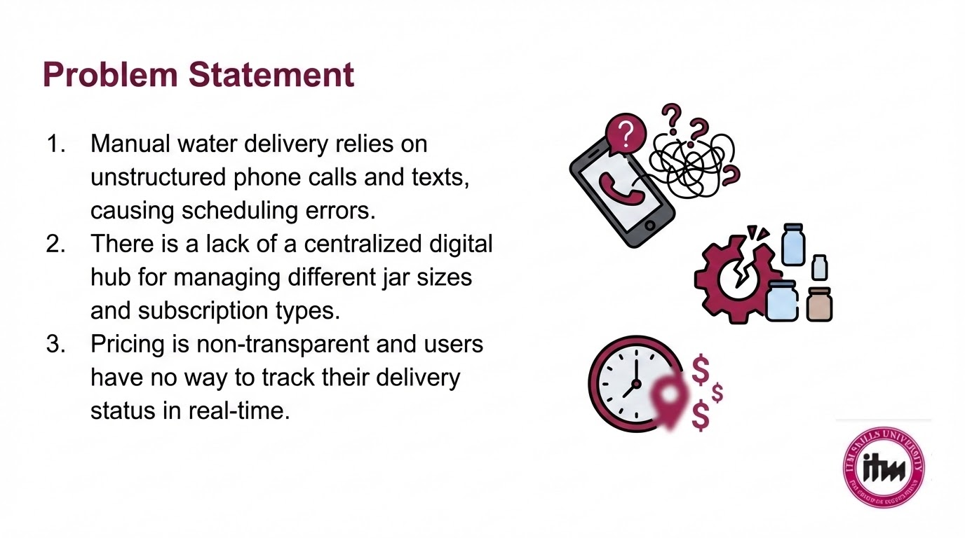

Slide 4
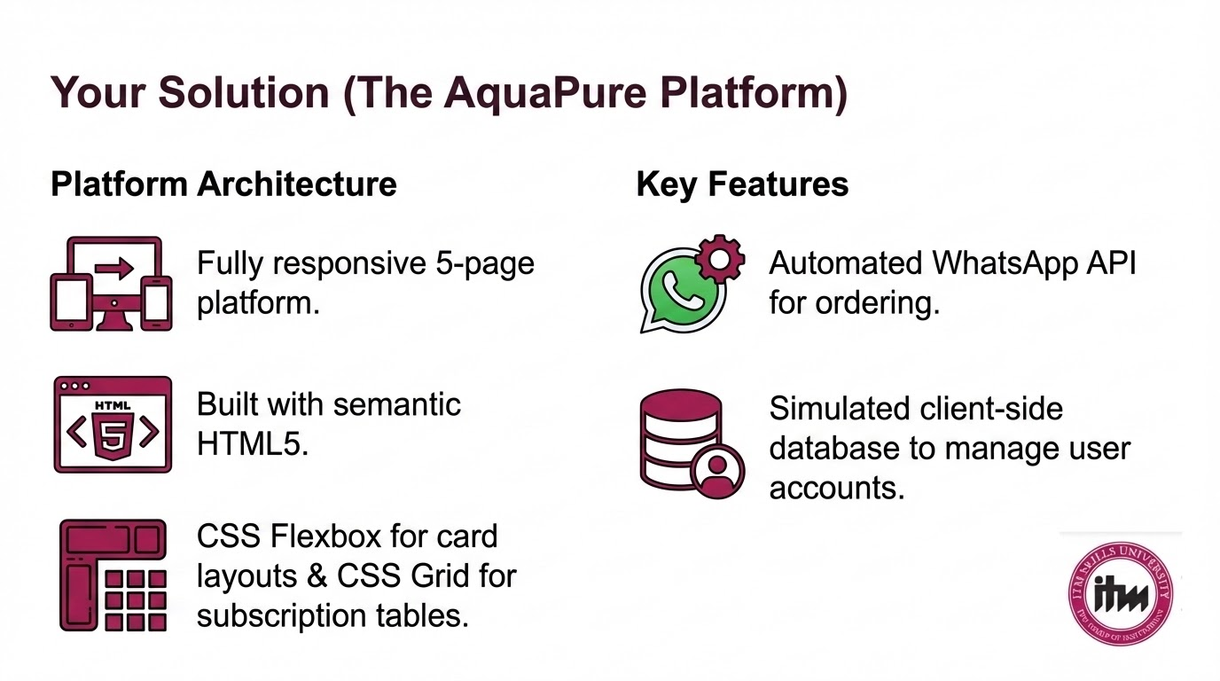

Slide 5
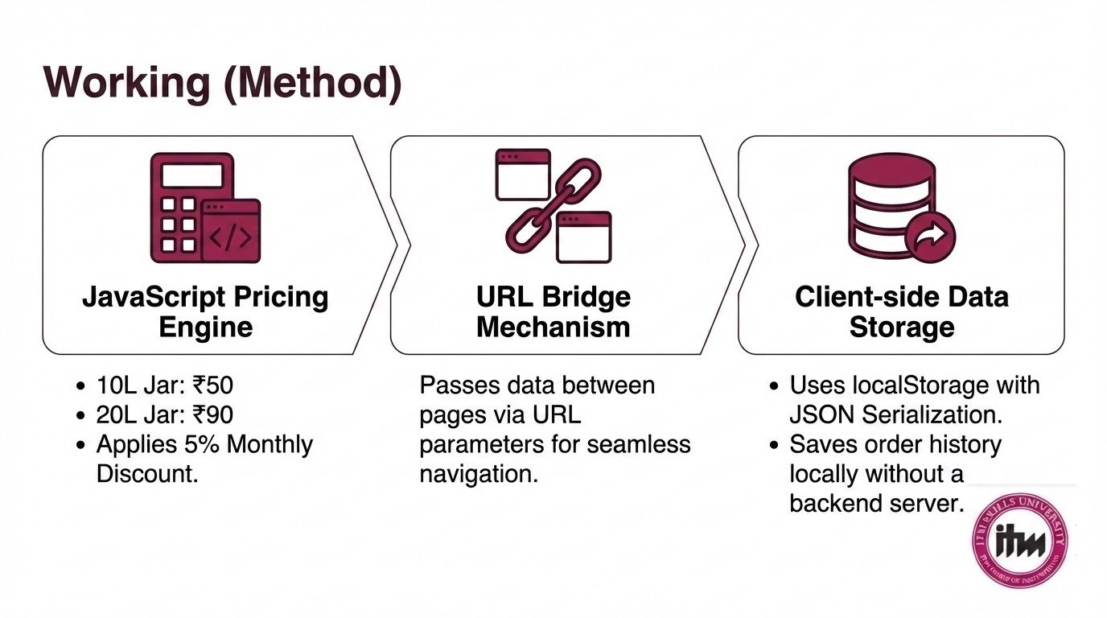

Slide 6
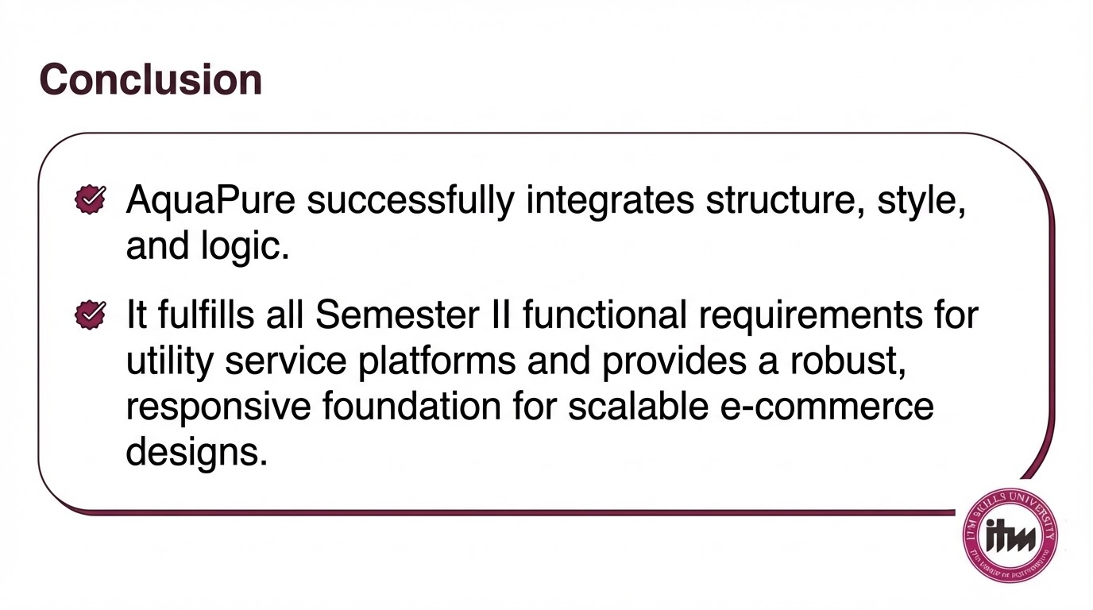

Slide 7
Thank You

